Slide 1
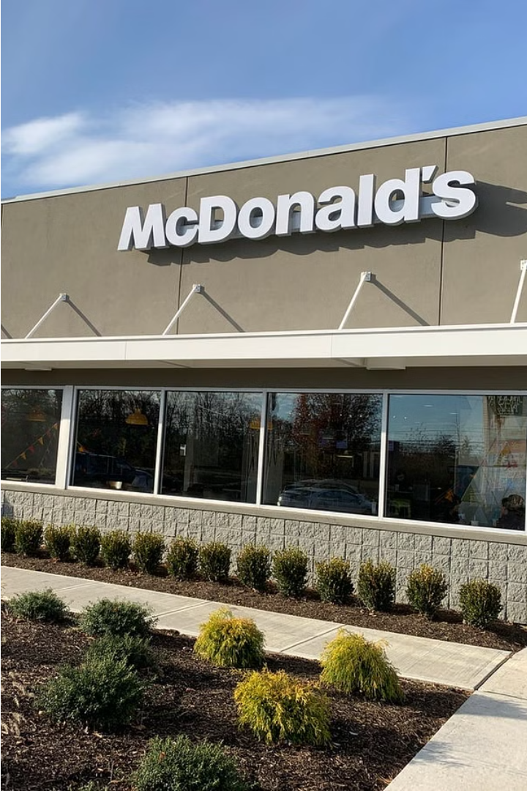
Exploring McDonald's Pasta Potential
As McDonald's explores expanding its menu to include pasta dishes, we'll dive into the perspectives of potential customers to uncover insights that can shape this new culinary direction.
Group 10 :
Meera Palanivel
Sasi Kumar
Praveena Venu
Niyati Mudliar
Abhishu Tailor
Nithin Thomas
Aravind Chintalapudi
Praveen Kumar Singh Jadon

Slide 2
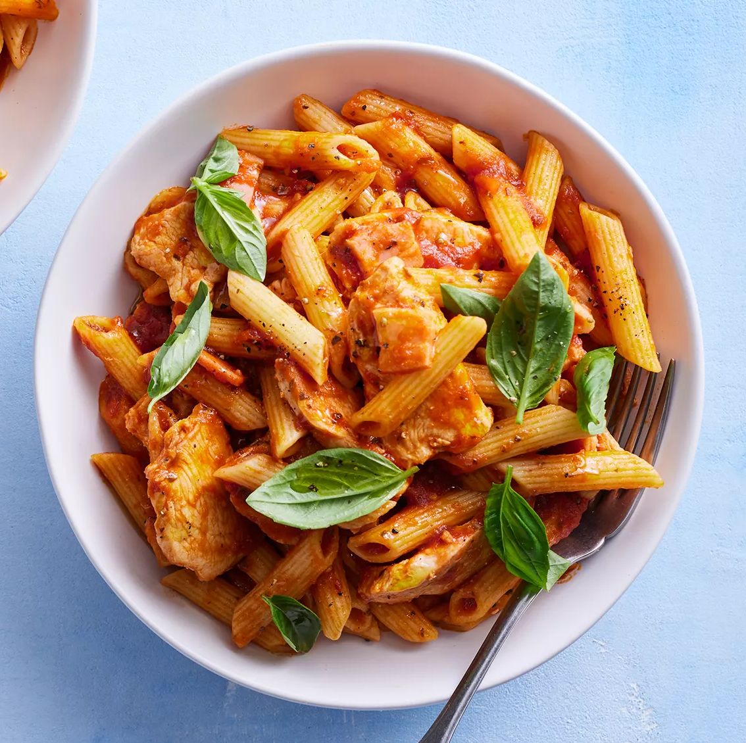
Focus Group Discussion (FGD) Guide: McDonald’s Pasta Launch:
1. Introduction:
Welcome participants and explain the purpose of the focus group.
Introduce the topic: McDonald’s potential launch of pasta in their dinner menu.
2. Icebreaker:
Ask participants about their general dining habits at McDonald’s.
Inquire if they ever consider pasta as an option when dining out.
3. Exploration of McDonald’s Brand Perception:
Discuss participants' perceptions of McDonald’s as a fast-food restaurant.
Ask about their expectations regarding the quality and variety of menu items.
4. Introduction of the Concept:
Present the idea of McDonald’s introducing pasta in their dinner menu.
Explain the potential types of pasta dishes, pricing, and meal options.
5. Feedback on Concept:
Ask participants about their initial thoughts and reactions to the idea of pasta at McDonald’s.
Inquire if they think pasta fits with McDonald’s brand image and target audience.
6. Exploration of Preferences:
Discuss participants' preferences for types of pasta dishes (e.g., spaghetti, penne, fettuccine).
Inquire about desired sauce options and additional toppings.

Slide 3

Focus Group Discussion (FGD) Guide: McDonald’s Pasta Launch:
7. Evaluation of Pricing and Value:
Gather opinions on the proposed pricing for pasta dishes at McDonald’s.
Assess participants' perception of value compared to other fast-food and casual dining options.
8. Discussion on Potential Challenges:
Explore any concerns participants may have regarding the introduction of pasta at McDonald’s.
Discuss potential challenges such as competition, preparation time, and customer acceptance.
9. Opinions on Marketing and Promotion:
Solicit ideas from participants on how McDonald’s could effectively market and promote their pasta offerings.
Discuss potential advertising channels and messaging strategies.
10. Conclusion:
Summarize key points discussed during the focus group.
Thank participants for their valuable input and insights.
Remember to facilitate the discussion in a way that allows all participants to share their opinions and ensure that the conversation remains focused on the topic of McDonald’s pasta launch.

Slide 4


Slide 5

Current Dining Habits
1
Frequent Visits
2
Variety Seekers
3
Pasta Curiosity
Many participants are regular McDonald's customers, visiting multiple times per week.
While burgers and fries are staples, some participants express interest in more diverse menu options.
A significant portion of the group indicate they would consider pasta if it were offered at McDonald's.

Slide 6
Brand Perceptions
Fast Food Expectations
Menu Limitations
Brand Evolution
Participants view McDonald's as a classic fast-food restaurant, prioritizing speed, convenience, and affordability.
Some express a desire for McDonald's to expand beyond its burger-centric menu and offer more diverse, high-quality options.
The group is generally open to McDonald's exploring new menu items, seeing it as a way to modernize and cater to evolving customer preferences.

Slide 7
Pasta Concept Reactions
Intrigued
Skeptical
Many participants are intrigued by the idea of pasta at McDonald's, as it could provide a familiar yet novel dining experience.
Some express concerns about the fit between pasta and McDonald's brand, questioning whether it aligns with the restaurant's core identity.
Cautiously Optimistic
Eager Anticipation
The group is generally open to the pasta concept, but would need to see high-quality execution and competitive pricing to be fully convinced.
A subset of participants are enthusiastic about the prospect, viewing it as an exciting new direction that could diversify McDonald's offerings.

Slide 8

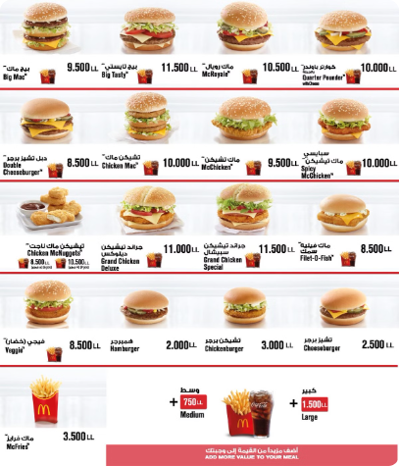
Pricing and Value
1
Affordability
Participants expect pasta dishes at McDonald's to be priced competitively, aligning with the brand's value-driven reputation.
2
Quality Expectations
While cost is important, the group also desires high-quality pasta preparations that justify the price point.
3
Perceived Value
The group believes pasta at McDonald's could offer a unique value proposition compared to other fast-food and casual dining options.

Slide 9
Pasta Preferences
Pasta Shapes
Sauce Options
Customization
Participants express interest in a variety of pasta shapes, including spaghetti, penne, and fettuccine.
The group suggests classic options like marinara, alfredo, and pesto, as well as more unique choices like garlic-parmesan or spicy arrabiata.
Participants desire the ability to customize their pasta dishes with add-ons like grilled chicken, meatballs, or fresh vegetables.

Slide 10
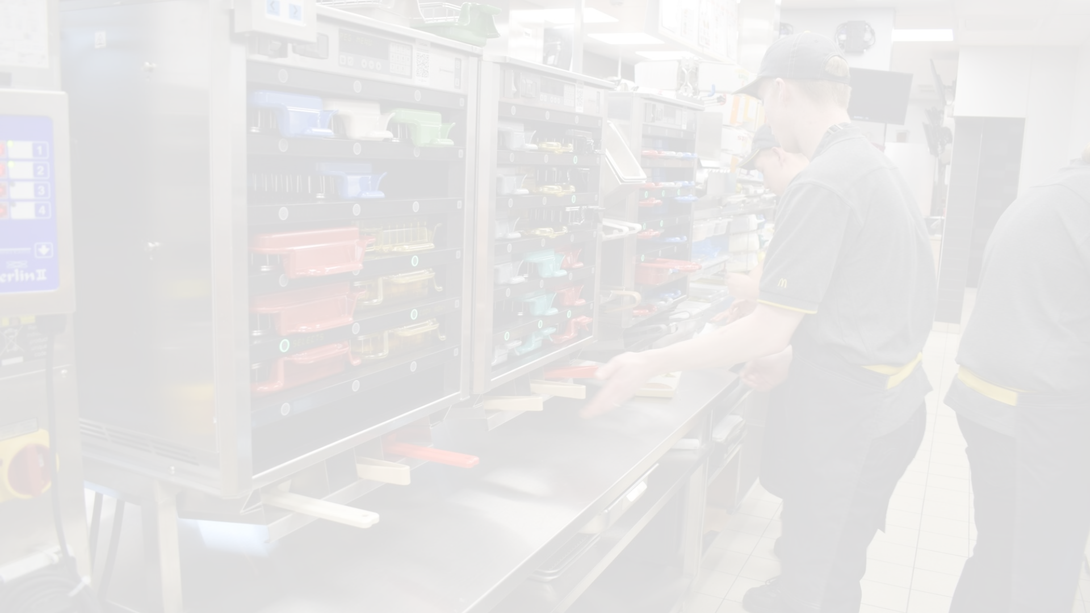
Potential Challenges
1
Preparation Time
2
Customer Acceptance
3
Competitive Landscape
Participants express concerns about the impact of pasta on McDonald's speed of service, a core brand attribute.
Some in the group wonder if pasta will resonate with McDonald's core customer base, who may expect a more traditional fast-food menu.
The group acknowledges the challenge of differentiating McDonald's pasta offerings from those of established casual dining chains.
However the major challenges are:
Cost-benefit analysis – The resources required to incorporate pasta into McDonald’s kitchen would include dedicated live-counters, space, skilled chefs, veggies, etc. which would significantly increase the production cost. If the benefits greatly outweigh the costs, the decision should go ahead.
The addition of Pasta in the menu would diversify the core competency of McDonalds. The after effects should be critically monitored in order to determine the long-term fate and necessary amendments.

Slide 11



Marketing Strategies
Social Media
Promotional Offers
In-Store Displays
Celebrity Partnerships
Leverage social media platforms to generate buzz and showcase the new pasta options in a visually appealing way.
Create engaging in-store displays and sampling stations to highlight the quality and freshness of the pasta offerings.
Consider introductory discounts or meal deals to incentivize customers to try the new pasta dishes.
Explore collaborations with popular food influencers or celebrities to lend credibility and excitement to the pasta launch.

Slide 12
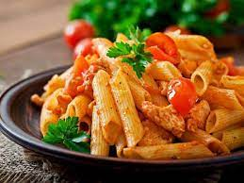
Conclusion:
The participants concluded the discussion with an emphasize on the following:
Cost-benefit analysis – The resources required to incorporate pasta into McDonald’s kitchen would include dedicated live-counters, space, skilled chefs, veggies, etc. which would significantly increase the production cost and thus the pricing of the food item. If the benefits greatly outweigh the costs, the decision should go ahead.
The addition of Pasta in the menu would diversify the core competency of McDonalds. The after effects should be critically monitored in order to determine the long-term fate and necessary amendments.
In the initial phase, the customers would look forward to try out the new menu, however, customer retention in the longer run looks to be challenging and highly depends on customer acceptance.

Slide 13


